Slide 1
AC22005
Section 2 - Lecture 4
Caching 3

Slide 2
Outline of this lecture
  More problems and solutions
  More on Intel processor caches
  Reference: Stallings, “Computer Organization and Architecture” (5th Ed.), pp. 117-136, 635-642
  Also see notes under “Other Learning Materials” on Blackboard

Slide 3

Thought for the Day

Slide 4
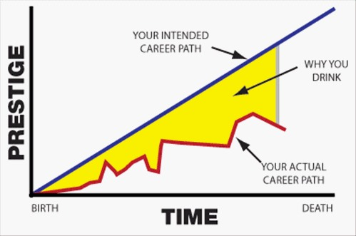
Graph of the Day

Slide 5
Revision: the cache
  a small but very fast area of memory close to the processor
  reduces the amount of s-l-o-w memory fetches by holding a local duplicate copy of recently-used data from main memory
  functions automatically, and is invisible to the processor (and OS and user)
  main memory is mapped into the cache in some way – usually set-associative
  fetches can result in a cache hit or miss

Slide 6
Some issues
  Usage:
    the cache must function automatically
    CPU performs more reads than writes
  Mapping: the cache is typically <1% of the main memory - so how do we map into it?
  Coherence: the cache contains a copy of memory locations, and integrity MUST be maintained in use (with no user intervention)
  Updating: Normally the cache is full - so where do we put new data as we read it in?

Slide 7
Cache Updating Schemes

Slide 8
Cache update strategies
When a new item is loaded from memory, it must be placed in the cache, which will (usually) already be full … so what do we replace? Three common strategies are used:
  least recently used (LRU): most effective, easily implemented with set associative
  first-in first-out (FIFO): implemented via a circular buffer
  least frequently used (LFU): need a hit counter on each way

Slide 9
Which way?
In a set-associative cache:
  which set is used is determined by the address being used (fixed)
  which way is used is determined at run time (dynamic):
    initially, the first available empty way in a set will be used, but once all ways are full, we must overwrite existing contents - but which one?

Slide 10
Which way?
Determining which way to overwrite is done algorithmically.
To support the operation of the replacement algorithm, the cache must hold some extra “housekeeping” bits, such as LRU bits.
These bits are dynamically updated during cache usage.
When new data comes in, the bits are used in the calculation of the way to be overwritten.

Slide 11
Cache sizes
Note that the cache sizes quoted in literature refer only to the data capacity of the cache.
If the cache needs to store tags and other “housekeeping” data, this requires more physical data storage on the silicon, but this is not shown in the quoted cache size.
e.g. 2-way, 256 sets, 128 data bits per way:
quoted size = 256 x 2 x 128 = 8192 bytes = “8K”
physical size = 256 x ((2 x (128 + 20)) + 1) = 9504 bytes = “8K”
address tag
LRU

Slide 12
Cache Coherence

Slide 13
Keeping the cache in hand
The cache is useful for speeding up memory accesses, but coherence is essential.
  Why is coherence important?
  How can cache coherence be maintained?

Slide 14
Cache coherence
The cache stores a copy of certain areas of main memory. If one is updated, we have a potential coherence problem (two different versions of the same data) - so we must either:
  ensure the cache and main memory are always coherent, or:
  use appropriate dynamic techniques to prevent coherence differences from causing problems
… especially in multi-processor systems …

Slide 15
Multi-level caches
Main Memory
Core 1
L1 Cache
L2
Cache
Core 2
L3
Cache
L1 Cache
L2
Cache

Slide 16
Multi-level caches
Main Memory
CPU 1
Core 1
L1 Cache
L2
Cache
Core 2
L3
Cache
L1 Cache
L2
Cache
CPU 2
Core 1
L1 Cache
L2
Cache
Core 2
L3
Cache
L1 Cache
L2
Cache

Slide 17
Reading and Writing
The cache is optimised for memory read access, as more reads than writes occur.
However, it is writes that lead to coherence problems (as data is being updated) - do we:
  update the cache and main memory, or:
  update the cache only?

Slide 18
Write-through
With a write-through (or “store-through”) cache, data writes update the cache and also go through to main memory:
  the cache is always coherent
  a main memory write cycle is required for every write

Slide 19
Write-back
With a write-back (or “copy-back” or “store-in”) cache, data writes only update the cache:
  cache and main memory are therefore not coherent after the write is performed
  a modified cache block is copied to main memory only when about to be overwritten in the cache (processor can continue)
  must note which blocks have changed
  only needs main memory write cycles when necessary

Slide 20
External coherence
Consideration of coherence between processor cache and main memory is not enough if we have a system with more than one processor or other bus-master (multi-core, DMA, etc.).
There are software and hardware protocols to monitor coherence e.g. the MESI protocol, as used in the Pentium.
Processors have to eavesdrop (“snoop”) on reads made by other processors in order to update the cache status of each processor.

Slide 21
MESI protocol
Stores two bits for each cache way, indicating one of four possible states for that data:
  Modified - data in this way is newer than in main memory - must be written back if another processor tries to read that address
  Exclusive - data in this way matches main memory and it is the only copy
  Shared - data in this way matches main memory but there are other copies
  Invalid - data is invalid or empty

Slide 22
Caches in the Pentiums

Slide 23

The Pentium Cache
The Intel Pentium has two on-chip caches:
  a data cache
  an instruction cache
Each cache is 2-way set associative with 128 sets each with a way size of 32 bytes.
It is possible for data items down to the size of a byte to be addressed in the cache.
Cache size = line size x # of ways x # of sets (8K)

Slide 24
The Pentium Cache
  Write-back used by default, but can be set to perform write-through caching
  Least-recently used (LRU) replacement algorithm is used
  A single LRU bit is associated with each set of two ways to indicate which way should be replaced first - stored in a 128-bit table
  N.B. LRU and MESI bits are not part of cache size calculations - data only!

Slide 25
Newer Processors
Pentium Pro:
  2 x 8K on-chip L1, 256K L2, 2 way
Pentium II, Pentium III:
  2 x 16K on-chip L1, 512K L2, 4 way
Pentium 4:
  12K Execution Trace Cache*, 8K L1 data cache, 256K L2, 8-way
* part of Intel’s NetBurst architecture; not used in later processors due to thermal problems

Slide 26

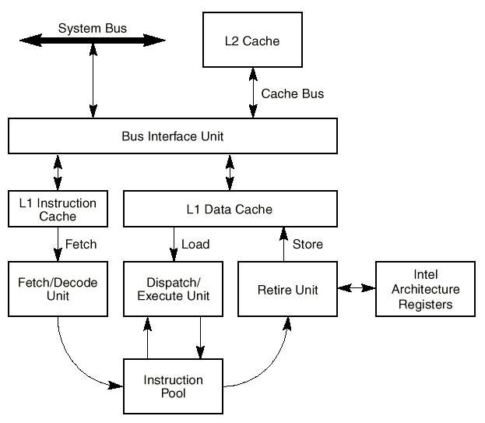
Pentium III Cache

Slide 27
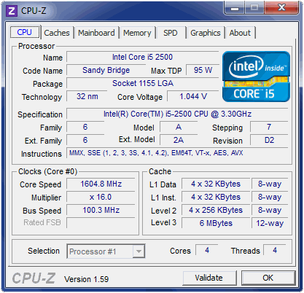
Your Cache

Slide 28
Cache Definition
We can now more clearly define a cache as:
  “a small storage area located close to a processing unit, which stores recently-used data taken from a larger, but more distant and slower, storage area”
This definition can apply to the CPU caches, disk caches … and to other caches that we will see later.

Slide 29
BUT REMEMBER …
  The cache does not speed up the calculations performed by the CPU
  The cache does not speed up the memory
  The cache does not speed up the memory read/write cycles
  The cache does not require management
  The cache does increase the overall speed of the CPU by getting it to perform fewer memory read/write cycles

Slide 30
Lab Connection
  You will work through some examples of cache usage in the computer-based tutorial in Lab Session 3
  You will see information on the caches in the Pentium series of processors in the Intel tutorial in Lab Session 4
  Next week’s lab - revision of the basic fetch-execute cycle using TOM (or continue with your C#)

Slide 31
Summary
We have seen:
  cache coherence - how to maintain it
  cache usage - how to fill it
  caches in the Intel processors
Next meeting:
  Monday at 4pm - memory management

